Slide 1
Energy Data Usage
Iot aNALYTICS

Slide 2
Customer Energy Usage – Seasonal Analysis
Energy Usage - Submeter Two
Spring 2007 - March 2007
Summer 2008 - August 2008
Winter 2009 - December 2009
Notes:
Looks at submeter 1 – voltage -

Slide 3
Data Modeled
Spring 2007
March 2007, 31days analyzed, hour intervals
Total Observations:
Summer 2008
August 2008, 31days analyzed, hour intervals
Total Observations:
Winter 2009
March 2009, 31days analyzed, hour intervals
Total Observations:

Slide 4
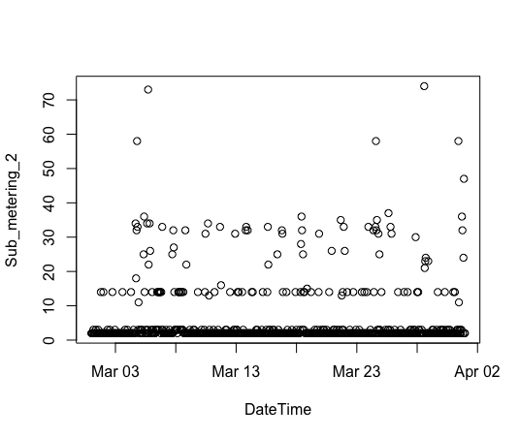
Customer Energy Usage – Submeter 2- Spring 2007
Average Watt Usage - 2.9 watts
Highest Usage - the highest of watt usage occurred with 74 watts on March 28th at 2pm and 73 watts on March 5th at 5pm
Most Frequent – Zero watts especially given overnight usage

Slide 5
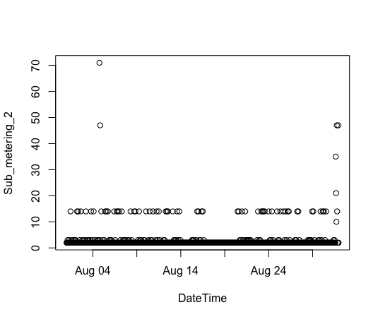
Customer Energy Usage – Submeter 2- Summer 2008
Average - 5 watts
Highest Usage - August 4th at 6pm (71 watts) and August 31st at 3pm (39 watts)

Slide 6
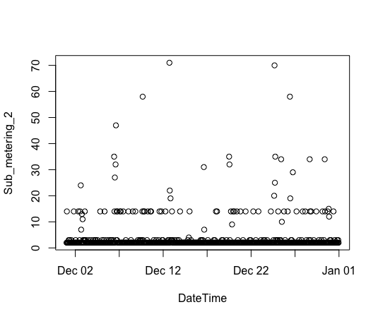
Customer Energy Usage – Submeter 2- Winter 2009
Average – 1.4 watts per hour
Highest - December 12th at 5pm (71 watts/hour) and December 24th at 4pm (70 watts/hour)

Slide 7
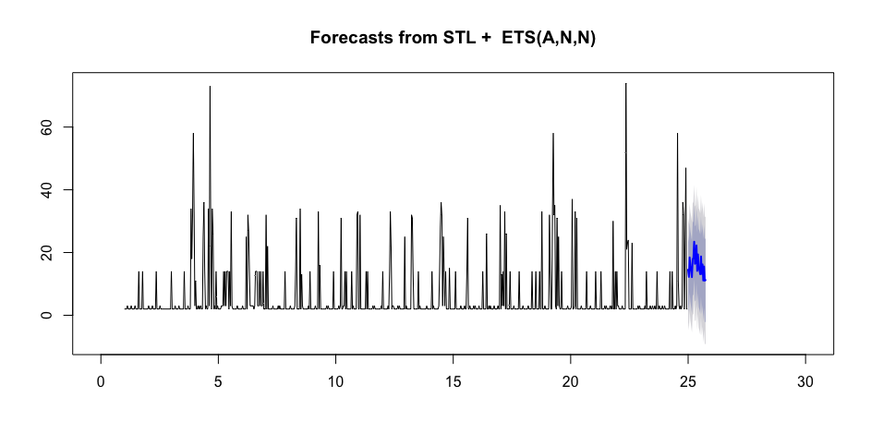
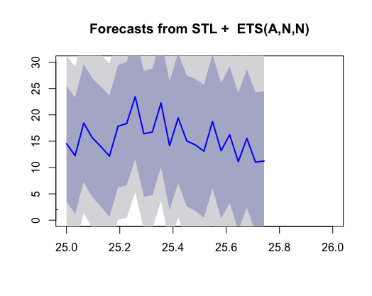
Predicting Future Usage – Spring 2007
As illustrated in the forecast, the prediction for energy usage for submeter 2 ranges around 10 to 25 watts. The second line chart below indicates for the prediction of usage the ranges of 10 to 25 watts and their corresponding time frames. Therefore from this analysis, the highest predicted spikes in energy usage in the beginning part of the day.

Slide 8
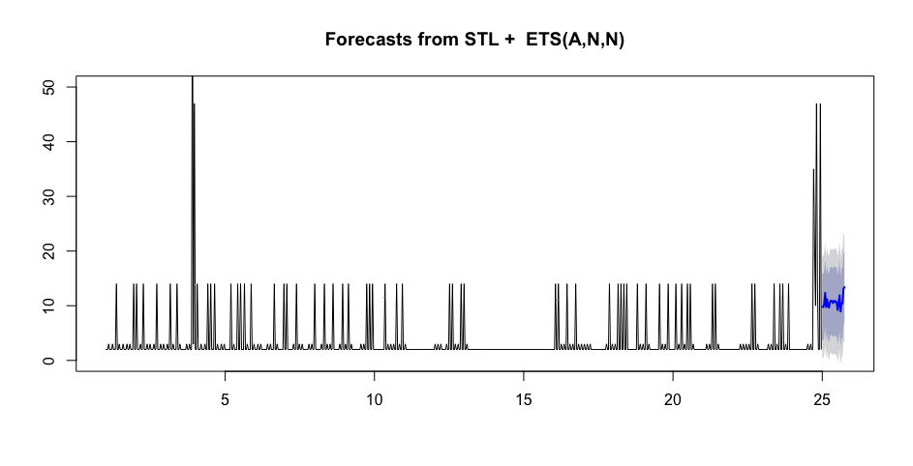
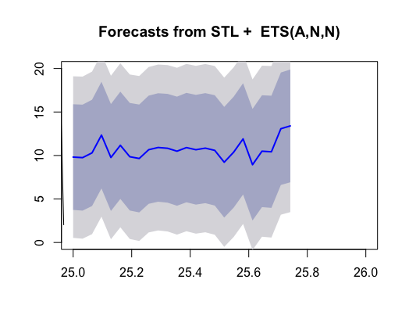
Predicting Future Usage – Summer 2008
The first chart shows the spike in submetering usage at the beginning and end of month with the forecast ranging near the 10 watt area.
The prediction for energy usage in submeter two follows a similar patterns to customer usages in that the increase in usages occur in the beginning and end of day. In comparison to the Spring 2007 data, the Summer 2008 data illustrate a more consistent range of energy usage (around 10-12 watts) and lower overall energy usage

Slide 9
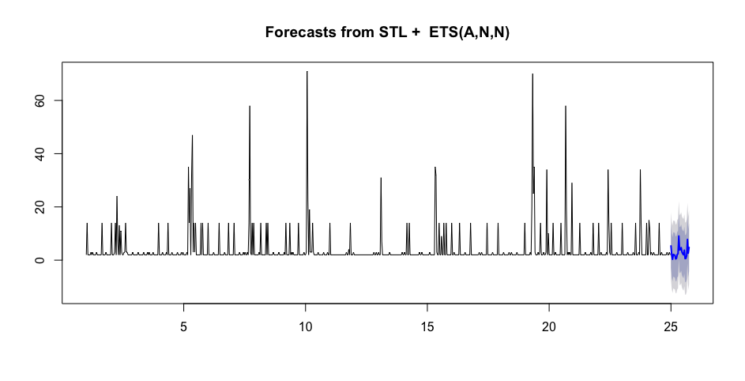
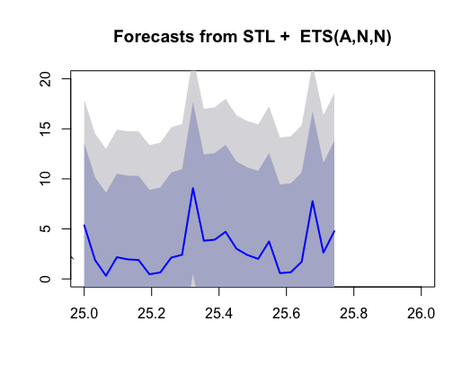
Predicting Future Usage – Winter 2009
The chart shows the spike in submetering usage around the 5th, 8th, 10th, 18th, and 22nd days of the month.
The second chart provides a more specific example of data usage for future prediction. In this forecast for Winter 2008, there are several low energy usage points as compared to the other seasonal times and higher spikes in usage from the middle of the day and end of day with an overall lower energy usage

Slide 10
Business Recommendations
Energy usage increase for at the beginning and end of month for Spring and Summer research ways and therefore it may be wise to research ways to reduce costs during these times.
Recommend correlating usage with other submeters to determine if use of laundry would be better at different time to save energy usage.
Energy usage increase later in the afternoon when people return from work and look for ways to automate appliances for convenient energy use.
Further analysis on different usage between washer and dryer and different appliance types.
Provide price comparison of submetering to regular energy usage.
Provide educational material for more effective usage for consumers.
Some causes of energy expenditure are poor insulation, inefficient windows, old or inefficient appliances, and inefficient AC. In order to better determine energy usage, it would be important to review these problem areas.
Provide description of data privacy protocol for energy usage.

Slide 11
Lessons Learned
Research data and business domain in pre-process phase.
Engage in several visualization steps to understand data relationships and patterns.
Detail steps as if you were teaching this to someone else.

